Slide 1

Introduction to Machine Learning
Simon Andrews, Laura Biggins
simon.andrews@babraham.ac.uk
v2023-08

Slide 2
Agenda for the day
What is machine learning
Different types of machine learning model
[Exercise] Running different models
How to evaluate models
[Exercise] Evaluating Models
Preparing Input Data
Running Models with tidymodels
[Exercise] Building your first model
Automation with Recipes and Workflows
[Optimising models]

Slide 3
What is Machine Learning?

Slide 4
Data Analysis Workflow
Raw Data
Visualisation
Exploration
Modelling
Prediction
Filtering Cleaning
Statistics
Reporting
Collection
Preparation
Formalisation
Outcome

Slide 5
Machine Learning Builds a Model to make Predictions
Data
Model
Prediction
Classification
Regression

Slide 6
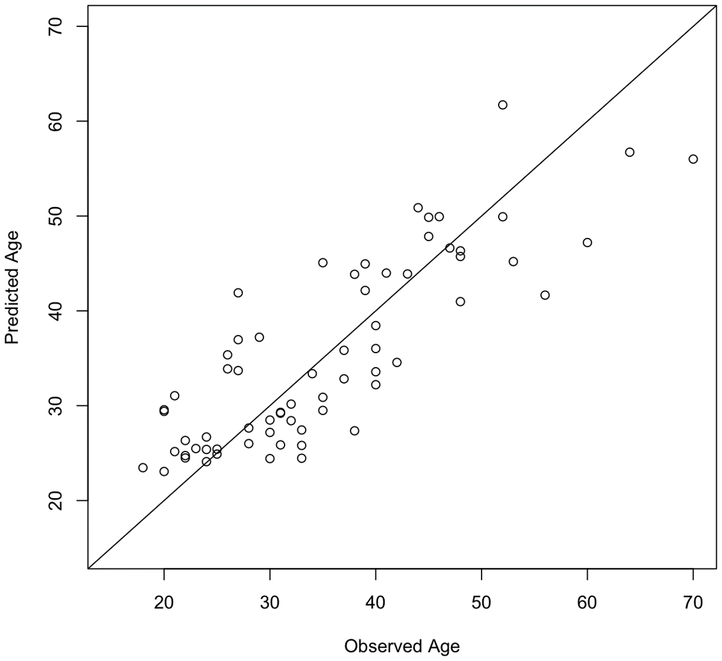

Biological Examples
Input: DNA Methylation from genomic CpGs
Output: Estimated biological age

Slide 7
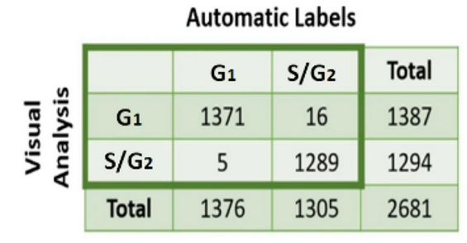
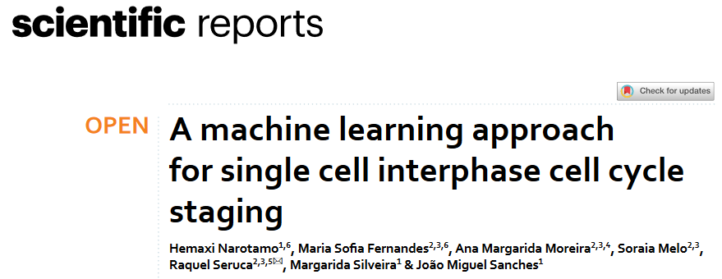
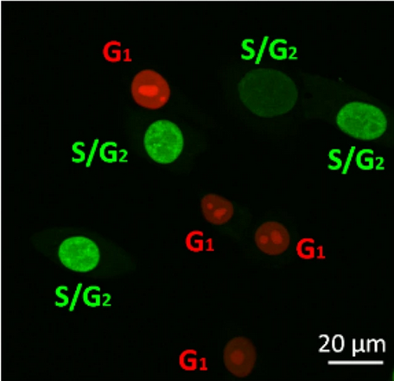
Biological Examples
Input: DAPI stained cell images
Output: Predicted Cell Cycle Stage

Slide 8
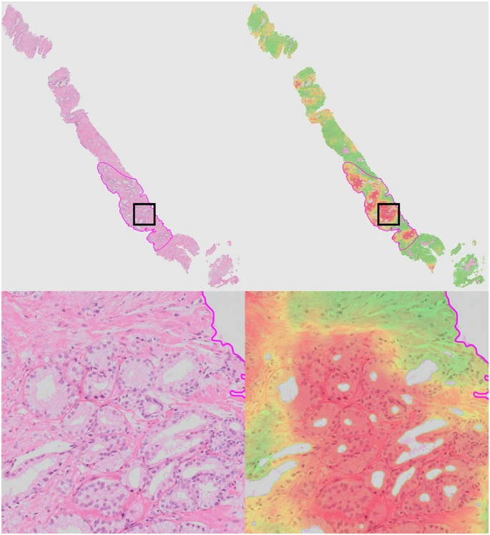

Biological Examples
Input: Histopathology slide images
Output: Cancer likelihood score

Slide 9
Steps in Machine Learning
Refine the model
Generate data for samples where the outcome is known
Pick a modelling method and build a model
Evaluate the model
Test the predictions
Make predictions where the outcome is not known

Slide 10
Different machine learning models

Slide 12
Differences between models
Outcome type
Regression models for quantitative predictions
Classification models for categorical predictions
Some model types can do both
Input type
Some models require all of their variables to be numeric
May need to convert categorical values to numbers
Expected behaviour of input data
Variation in the number of viable measures

Slide 13
K-Nearest Neighbours (KNN) models

Slide 14
K-nearest neighbours
Add a new point
Find the K (5 in this case) closest points
Count the categories in the closest points
The highest vote wins
= 3 votes
= 1 vote

Slide 15
Distance Measures
Euclidean Distance
Manhattan Distance
Hamming Distance
Jaccard Distance
…
Euclidean
Manhattan
A
B
C
D
E
F
Sample 1
Sample 2
Hamming = 2 differences

Slide 16
Support Vector Machines
Projects data into a multi-dimensional space
Divides the space into areas representing different categories
"Hyperplane"
Group 1
Group 2
Margin
"Support Vectors"

Slide 17
Clever Support Vector Machines
Group 1
Group 2
Group 1
Hyperplane positions generated after multiple runs with different subsets to optimise positions

Slide 18
Clever Support Vector Machines

Slide 19
Naïve Bayes Models

Slide 20
Naïve Bayesian
Bayes' Theorem states that the conditional probability of an event, based on the occurrence of another event, is equal to the likelihood of the second event given the first event multiplied by the probability of the first event.
We calculate a set of probabilities for each variable, based on the "Disease Linked Classification"

Slide 21
Categorical Probabilities
p Chr1 | Disease = 5 / 8 = 0.625
p Chr2 | Disease = 2 / 8 = 0.250
p ChrX | Disease = 1 / 8 = 0.125
p Chr1 | Non Disease = 6 / 76 = 0.079
p Chr2 | Non Disease = 20 / 76 = 0.263
p ChrX | Non Disease = 50 / 76 = 0.658
Disease genes are more likely to be on Chr1 and Non Disease genes are more likely to be on ChrX

Slide 22
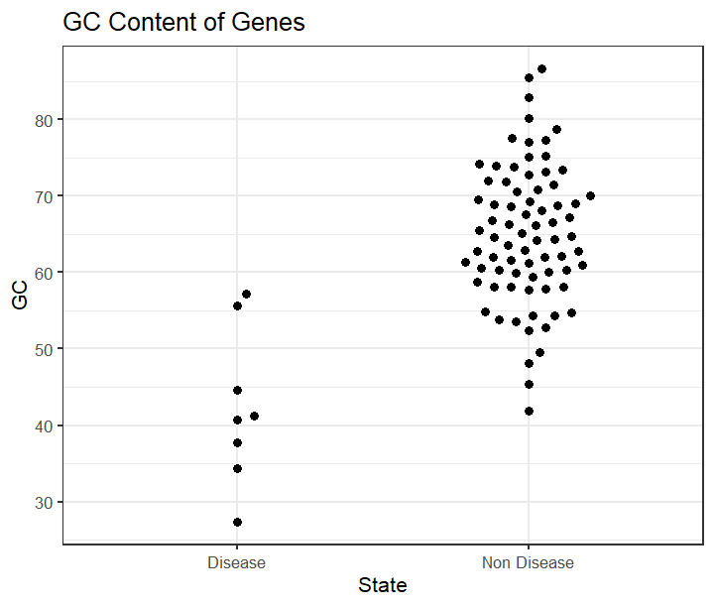
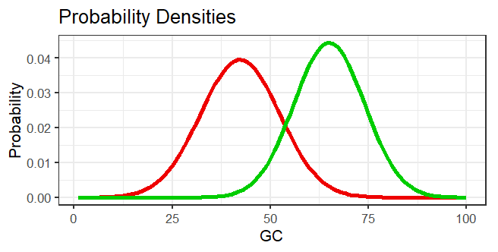
Quantitative Probabilities
State mean stdev
Disease 42.3 10.10
Non Disease 65.0 8.99
Disease
Non-Disease
40

Slide 23
Naïve Bayes Predictions
Predict the state for a new datapoint
Chromosome is 1
GC content is 40%
Disease
Non
-
Disease
Prior
(8/84) = 0.095
(76/84) = 0.905
(starting assumption)
Probability Chr1
0.625
0.079
Probability 40% GC
0.038
0.001
Total
0.0022
0.00007
New data is predicted to be Disease

Slide 24
Decision Trees

Slide 25
Predict Cancer Risk with a Decision Tree
Smokes?
Smokes?
Yes
No
Age <50?
Age <50?
Obese?
Yes
No
Yes
No
Exercises?
Exercises?
High
Exercises
Low
Yes
No
Yes
No
High
Low
High
Low
High

Slide 26
How do you build a tree?
From a population of observations
Which variable do you use?
[If quantitative] which cutoff do you use?
Answer: you calculate an ‘impurity’ score and pick the least ‘impure’ variable to split the remaining data
Want to use the most cleanly predictive question to improve the tree

Slide 27
Calculating Categorical Impurity
30
70
Smoker?
1 – (18/20)² – (2/20)²
0.180
1 – (12/80)² – (68/80)²
0.255
Yes
Outcome is ‘impure’ because there are a mix of high and low risk individuals in each node.
No
18
2
12
68
Node impurity = 1 – (p High)² – (p Low)²
Weighted Average of Node Impurities = 0.18 * (20/100) + 0.255 * (80/100) = 0.24

Slide 28
Calculating Quantitative Impurity
Age <= 25 = 1 Low 0 High, Age >25 = 3 Low 2 High, Impurity = 0.40
Age <= 32 = 2 Low 0 High, Age >32 = 2 Low 2 High, Impurity = 0.33
Age <= 34 = 3 Low 0 High, Age >34 = 1 Low 2 High, Impurity = 0.22
Age <= 58 = 3 Low 1 High, Age >58 = 1 Low 1 High, Impurity = 0.42
Age <= 64 = 3 Low 2 High, Age >64 = 1 Low 0 High, Impurity = 0.40

Slide 29
Pruning Trees
Lower branches may provide minimal additional information
Leaves don’t need to be completely pure
Can terminate the tree early and pick the majority answer
8
1
Swims
0
1
8
0
Yes
No

Slide 30
Random Forests

Slide 31
Random Forest
Decision trees can be fragile
Prone to overfitting
Many trees are better than one!
Bagging
Bootstrapping
Selecting multiple random subsets of data
+
Aggregating
Making many predictions and voting

Slide 32
Bootstrapping Two Levels of Randomisation
Original
Random
x
x
x
“Out of Bag”
Smoker | Exercises
Age | Exercises
Age | Smoker
Build tree with random selection of variables at each branch point

Slide 33
Build a Forest (hundreds of trees)
Evaluate
Run the “out of bag” data through the trees
See how often they predict correctly
Vary random variable number to optimise
Predict
Run new data down all trees
Count the predicted outcomes
Most frequent outcome wins

Slide 34
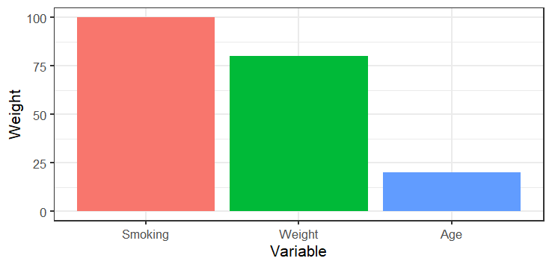
Feature Selection
Smoker | Exercises
Age | Exercises
Age | Smoker
Smoker | Exercises
Age | Exercises
Age | Smoker
More informative features will appear higher up the tree.
Can aggregate this information across the forest

Slide 35
Neural Networks

Slide 36
Neural Networks
Node
Activation Value
(between 0 and 1)
0.1
0.6
0.9
0.2
0.5
0.9
Layer

Slide 37
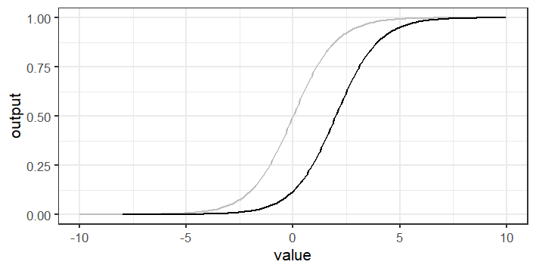
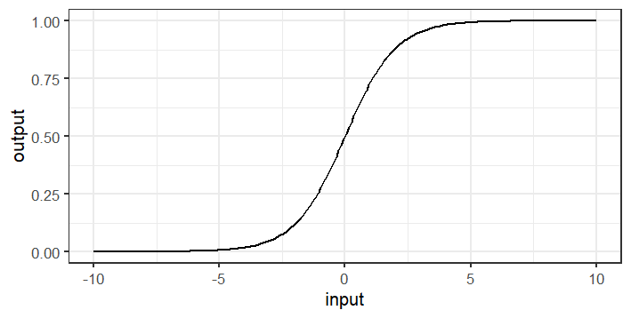
Calculating Node Values
(0.1 x 0.5) + (0.9 x 3.1) + (0.5 x -1.9) = 1.89
0.1
Weight
Sigmoid output = 0.87
+0.5
Sigmoid output (bias 2) = 0.47
0.9
+3.1
?
0.5
-1.9
Training = Calculating Weights and Biases

Slide 38
Neural Network Structure
Weight
Height
Age
Disease
Smokes
No Disease
Exercises
Diet
History
Input
Hidden
Output

Slide 39
Using the network
Weight
Height
Age
Disease
Smokes
No Disease
Exercises
Diet
History
Input
Hidden
Output

Slide 40
Training the network Selecting the number of hidden layers
Number of layers changes the type of relationships modelled
0 hidden layers = linear relationship, similar to linear modelling
1 hidden layer = nonlinear relationships
2 hidden layers = nonlinear relationships with arbitrary boundaries
Most problems only require 1 hidden layer. More complex data can benefit from 2. Virtually nothing requires more than two.

Slide 41
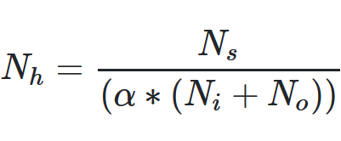
Training the network Selecting the number of nodes in hidden layers
Too few nodes will not allow enough complexity to model the system effectively
Too many nodes will overfit – essentially "memorising" the training data
Number of hidden layer nodes should be between the input number and the output number
Simple
Try 2/3 input number plus output number
Complex
Nh = number of hidden nodes
Ni = number of input nodes
No = number of output nodes
Ns = size of training set
α = scaling factor (normally 2)

Slide 42
Training the network Selecting weights and biases
Generate a "cost function" – a numerical value which says how well the model performed on the training data (high = bad, low = good)
Could just be how good the predictions are, but often good to include how complex the connections are
Start by initialising the weights / biases to random numbers
Shuffle the values to gradually minimise the cost function value

Slide 43
Training the network Back Propagation
0.8
How do you increase a value?
Increase positive weights
Tied to high activations upstream
Decrease negative weights
Tied to high activations upstream
What doesn't matter?
Anything with a low weight
Anything with a low upstream activation
Should be higher
0.9
Should be higher
0.6
Disease
0.1
0.7
No Disease
0.1
Should be lower
0.9
Should be lower
Prediction for a single disease sample
Average across all samples and then adjust

Slide 44
Cleaning the network
Weight
Good idea to minimise the network
Remove nodes where all output weights are low
Having little effect on the rest of the network
Height
Age
Smokes
Exercises
Diet
History

Slide 45
Exercise: Trying different models

Slide 46
Evaluating Models

Slide 47
A good model?
DC
Disease Corp
In a recent study our new AI model correctly predicted the disease status of 980 out of 1000 patients – that’s a 98% success rate!
Non diseased, predicted correctly (980)
Non diseased, predicted incorrectly (10)
Diseased, predicted incorrectly (10)

Slide 48
Baseline for comparison
1000 patients, 10 have disease
Assign most common category (healthy) to everyone
990 correct = 99% success!
A good model must do better than this.

Slide 49
Evaluating Qualitative Models
False Negative
False Positive

Slide 50
Evaluating Qualitative Models
(88+24) = 112 correct
(4+6) = 10 incorrect
Overall = 92% correct
(88+4) = 92 correct
(4+1) = 5 incorrect
Overall = 95% correct
(78+28) = 106 correct
(0+16) = 16 incorrect
Overall = 91% correct

Slide 51
Sensitivity vs Specificity
Sensitivity: How likely is the model to identify diseased patients correctly
Specificity: How likely is the model to identify healthy patients correctly
Overall = 92% correct
Sensitivity = 24/28 = 86%
Specificity = 88/94 = 94%
Overall = 95% correct
Sensitivity = 4/8 = 50%
Specificity = 88/89 = 99%
Overall = 91% correct
Sensitivity = 28/28 = 100%
Specificity = 78/94 = 83%

Slide 52
Sensitivity vs Specificity
What matters more?
Overall = 92% correct
Sensitivity = 24/28 = 86%
Specificity = 88/94 = 94%
Overall = 95% correct
Sensitivity = 4/8 = 50%
Specificity = 88/89 = 99%
Overall = 91% correct
Sensitivity = 28/28 = 100%
Specificity = 78/94 = 83%
Getting both is ideal – obviously!
If never missing disease is the main concern favour sensitivity
If not incorrectly false predictions is important favour specificity
Need to consider the frequency of true positives

Slide 53
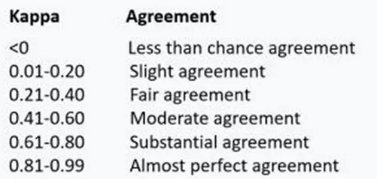
Cohen's Kappa Score
Measures whether the predictions are correct more often that you'd expect if the model was just guessing
Takes into account the proportion of predictions and observations in each class

Slide 54
Evaluating Quantitative Models
How close are the predictions to the true values?
Doesn’t matter if the mistake is high or low
Need a single value to summarise the total error

Slide 55
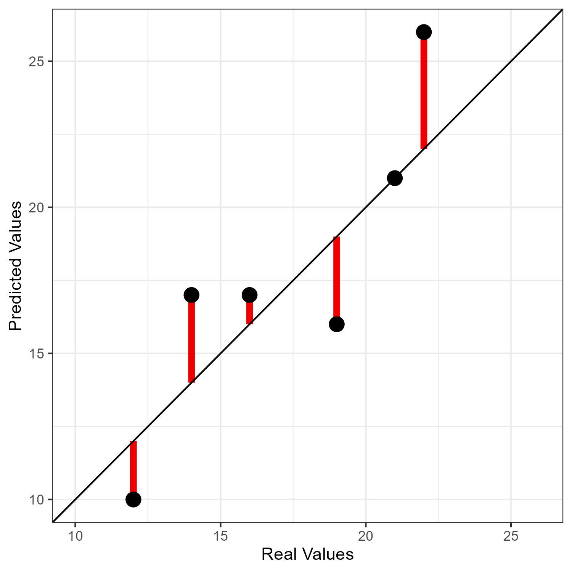
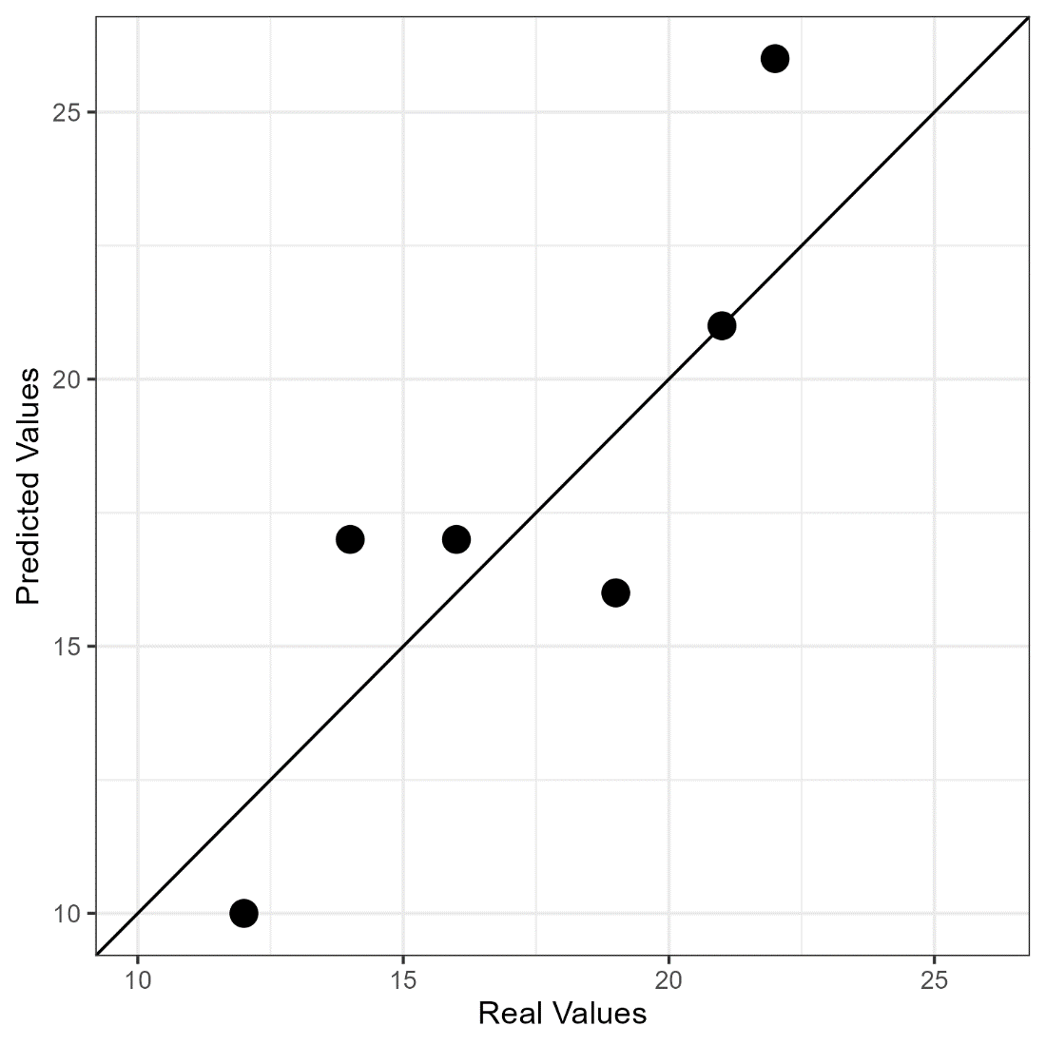
Evaluating Quantitative Models
Differences (+ and -)
Square differences (all positive)
Sum differences = single value
Sum of Squared Differences
SSD
Line of perfect fit

Slide 56
Making best use of your data when building and testing models

Slide 57
Data is Precious
Training the model
Model sensitivity = 95%
Model specificity = 98%

Slide 58
Overfitting
Has my model learned useful trends from the data, or just 'memorised' the training data?
Model:
If weight is >=28 or weight <=19 Sex is FEMALE
Otherwise Sex is MALE
Rules are too specific
Works brilliantly on the training data
Won't work well on new data
You can't evaluate a model using the same data used to train it

Slide 59
Data is Precious
Random Splitting
Majority of Data for Training the model
Minority of Data for Testing the model

Slide 60
Weighted Training Selection
Test Data
All disease samples are in the testing set
Nothing left to train on.
Biased selection maintains a balance of outcomes in each group
Training Data

Slide 61
Performance could depend on data split
90% Accurate Model
80% Accurate Model

Slide 62
Cross Validation
Train
Test

Slide 63
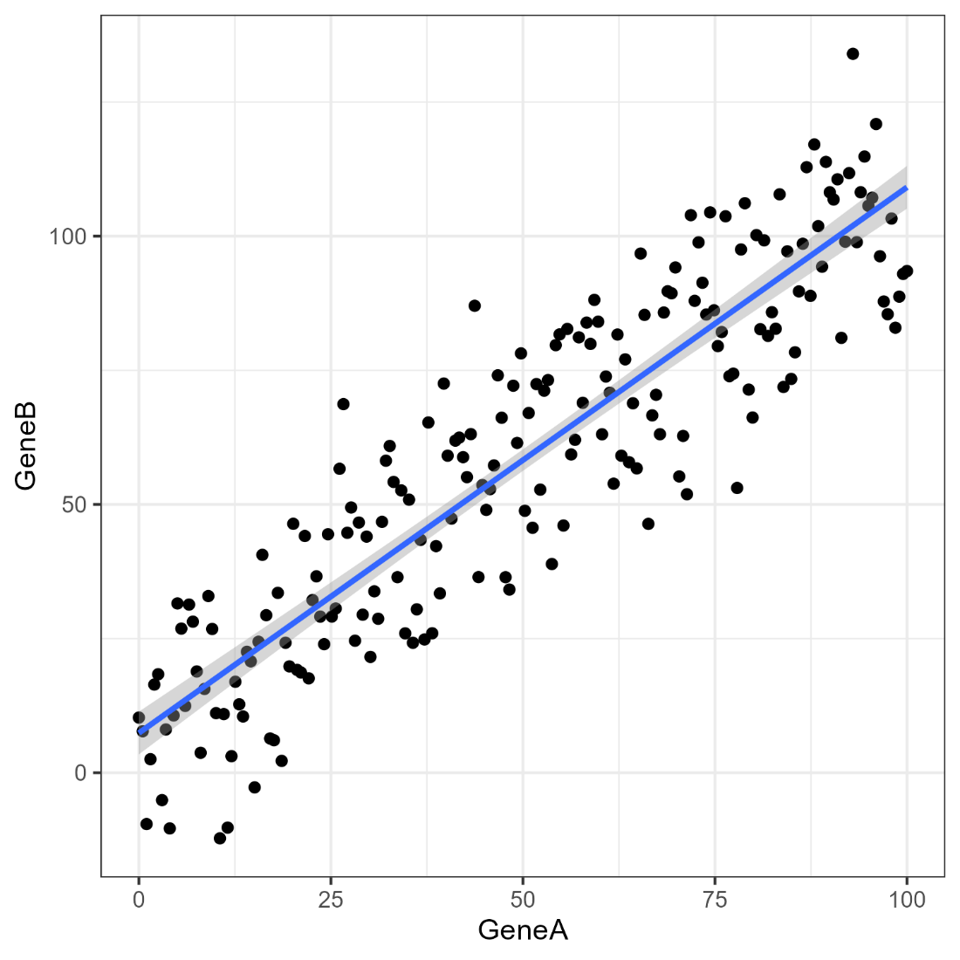
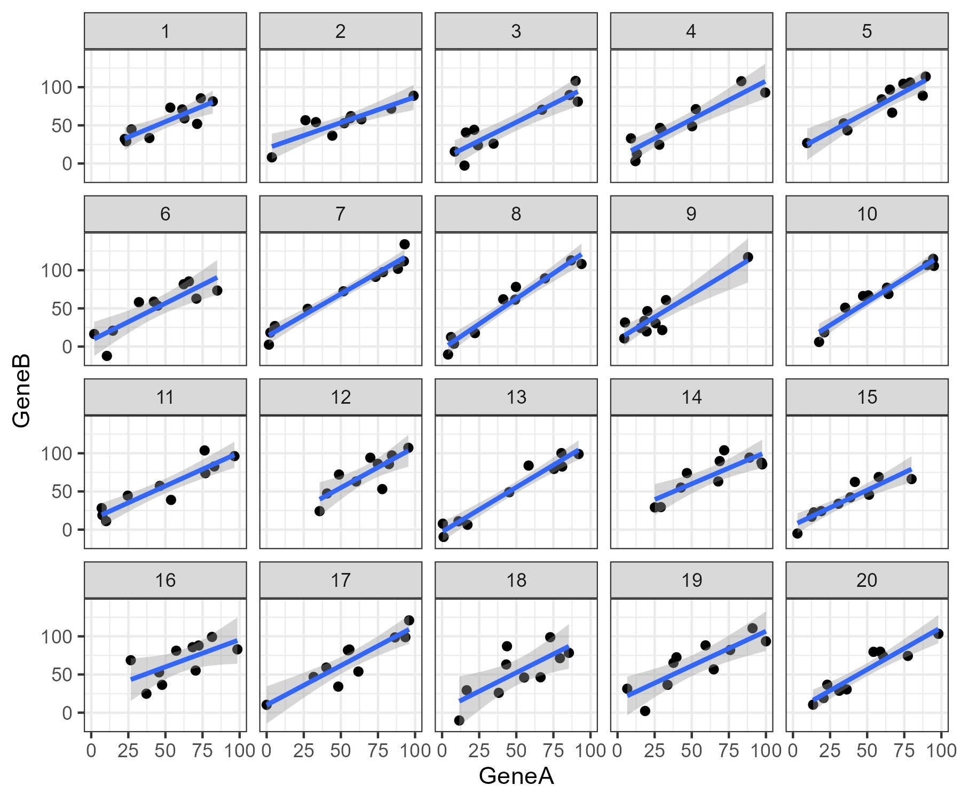
Cross Validation

Slide 64
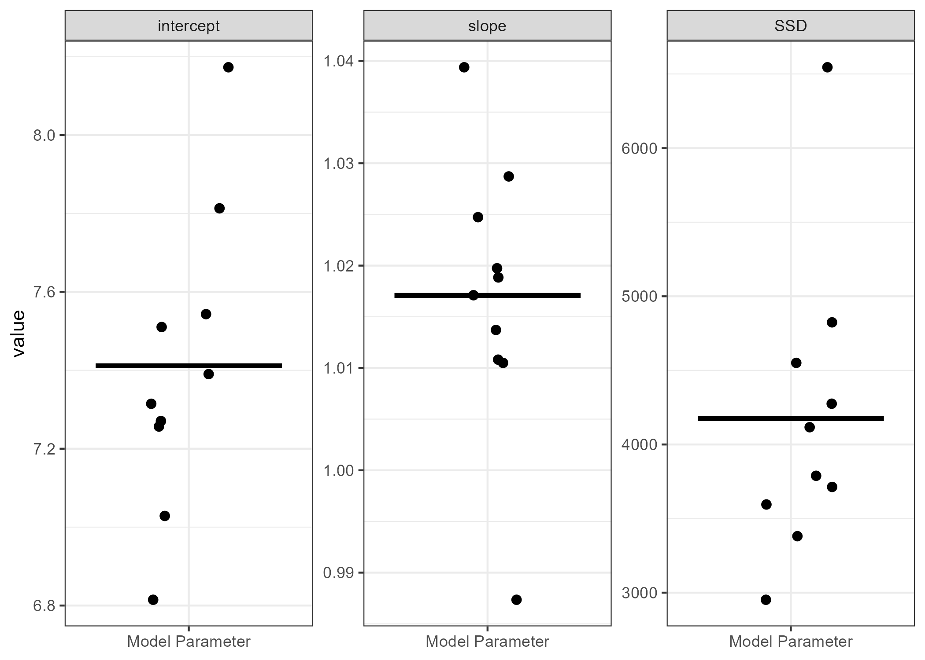
10-Fold Cross Validation

Slide 65
Exercise: Evaluating Models

Slide 66
Input Data

Slide 67
Garbage in = Garbage out
Noisy Variables
Outliers
Poorly Scaled Variables
Duplicates
Conflated Signals
Poorly Constructed Features
Missing Data
Data Leakage
Data Cleaning, Filtering, Scaling and Feature Construction

Slide 68

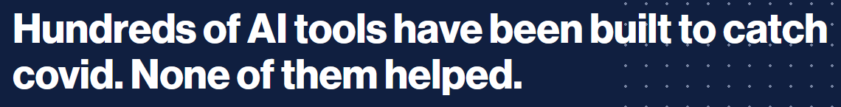
Common Data Problems Data Leakage
Accidentally including something unintentional which reveals the true prediction for the case
Audio clips from right whales were shorter than those from other species.
The right whale clips were next to each other in the dataset
Healthy scans came from children
Healthy scans came from people lying down
Models recognised the font on the scan pictures

Slide 69
Common Data Problems
Outliers
Extreme values, or just mistakes, will skew summary metrics
Missing values
Handled poorly by many models, either remove, or impute
Noisy variables
Variables with no connection to the question. Slow modelling and make results worse
Different scales
Quantitative models benefit from having variables with similar ranges of values

Slide 70
Preprocessing Converting to Numbers
Some models require all data to be numeric
Linear Models, SVM, Neural Nets
Some don’t care
Decision trees, Random Forest
Blue
Red
Purple
Orange
Green
1
0
0
0
0
Blue
Red
Purple
Orange
Green
0
0
1
0
0
0
1
0
0
0
0
1
2
3
4
0
0
0
0
1

Slide 71
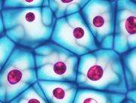
Preprocessing Converting to Numbers
8
1
1
5
3
2
0
1
9
8
2
1
3
1
6
0
2
8
4
2
6
2
1
1
2
1
8
0
1
7
1
1
1
1
2
7

Slide 72
Preprocessing Infrequent Categories
IG 596
OTHER 7059
Small RNA 5880
Pseudogenes 710
Structural RNA 82

Slide 73
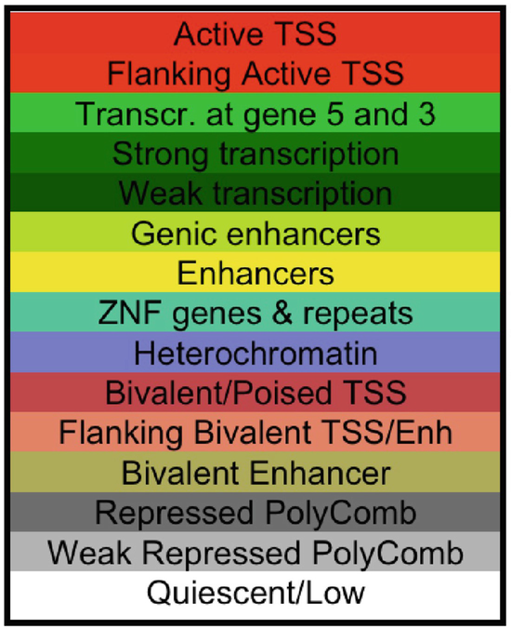
Preprocessing Feature Engineering
31-07-2023
Monday
July
2023
Summer
Q3
End of month

Slide 74
Preprocessing Scaling and Normalising
Some models expect numerical data which behaves in a roughly normal manner
Naïve Bayes, Linear Modelling, Neural Nets
Transformations make data more usable
Log transformation
Mean centering
Z-score normalisation
Converting to ranks
More advanced transformations
PCA to remove noise

Slide 75
Preprocessing Data Filtering
Good idea to reduce the data complexity
Remove noise
Reduce size (runs quicker)
Remove variables or cases which aren't helpful
Outlier values
Poorly measured features
Redundant features
Features with no variability

Slide 76
Practical Machine Learning using R and tidymodels

Slide 77
Baseline R Come on an R Course!
https://www.bioinformatics.babraham.ac.uk/training.html#rintrotidy
https://www.bioinformatics.babraham.ac.uk/training.html#advancedrtidy
https://www.bioinformatics.babraham.ac.uk/training.html#ggplot

Slide 78
R Syntax
A 'pipe'
Passes data from left to right
forest_fit %>%
predict(data) %>%
bind_cols(data) -> prediction_results
Function 'arguments'
Options for the function
Assignment arrow
Saves data to a variable
Variables (data structures)
Functions (do stuff and give something back)

Slide 79
Packages for machine learning in R
lm
nnet
rpart
brulee
kknn
ranger
h2o
mboost
spark
glmnet
keras
partykit
aorsf
stan
kernlab
thief
tbats
survival
xrf
hurdle
aorsf
gee
lmer
mgcv
All have their own conventions for preparing data and building models

Slide 80
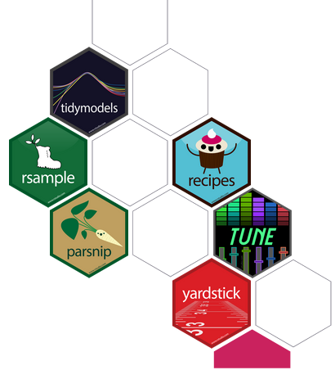

TidyModels
https://www.tidymodels.org/
Provides a consistent interface to prepare data, construct models and evaluate results.
Easy to move between different modelling packages with minimal code changes.

Slide 81
Input Data
Tibble of data (2D Spreadsheet)
rows are observations (cases) columns are variables
Classification variables must be factors (not text)
Standard exploration / plotting should happen before modelling

Slide 82
Code Structure
Create a model
No data yet, just the type of model and the settings to use
Create your data
Prepare and filter the input data
Split off training / testing data, or set up cross validation
Train the model
Pass the data to the model and define the variable to predict
Test / Use the model
Use the trained model to predict new values

Slide 83
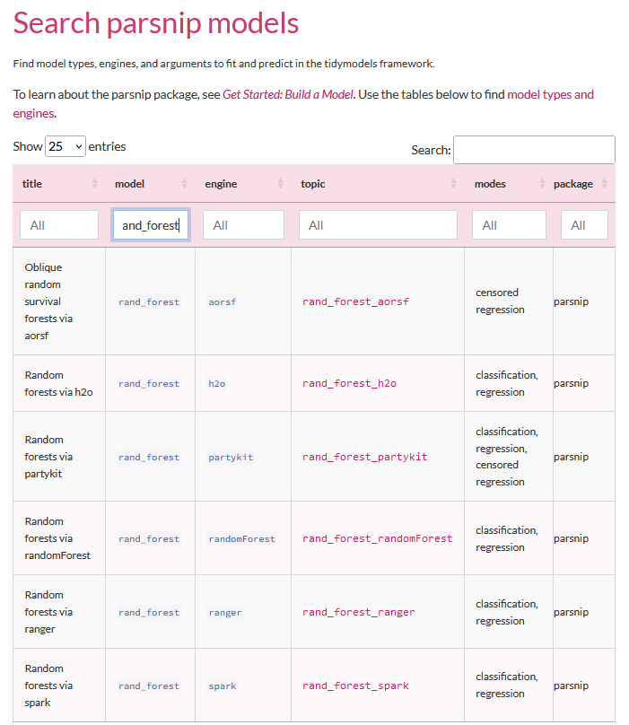

Create a Model
You need
A model type
An engine
A mode
Options
https://www.tidymodels.org/find/parsnip/

Slide 84
Create a Model
library(tidymodels)
tidymodels_prefer()
rand_forest(trees=100, min_n=5) %>%
set_mode("classification") %>%
set_engine("ranger") -> model
Model Options
The model
function
Model Type
The back end engine

Slide 85
Examine the model
model %>% translate()
Random Forest Model Specification (classification)
Main Arguments:
trees = 100
min_n = 5
Computational engine: ranger
Model fit template:
ranger::ranger(x = missing_arg(), y = missing_arg(), weights = missing_arg(),
num.trees = 100, min.node.size = min_rows(~5, x), num.threads = 1,
verbose = FALSE, seed = sample.int(10^5, 1), probability = TRUE)

Slide 86

Creating Data
read_delim("development_gene_expression.txt") -> data
data %>%
mutate(Development=factor(Development)) -> data
set.seed(123)
data %>%
sample_frac() -> data

Slide 87

Splitting Data
data %>%
initial_split(prop=0.8) -> split_data
training(split_data)
# A tibble: 992 × 93
testing(split_data)
# A tibble: 249 × 93

Slide 88
Splitting Data
data %>%
vfold_cv(v = 10) -> cv_data
# 10-fold cross-validation
# A tibble: 10 × 2
splits id
1 <split [1116/125]> Fold01
2 <split [1117/124]> Fold02
3 <split [1117/124]> Fold03
4 <split [1117/124]> Fold04
5 <split [1117/124]> Fold05
6 <split [1117/124]> Fold06
7 <split [1117/124]> Fold07
8 <split [1117/124]> Fold08
9 <split [1117/124]> Fold09
10 <split [1117/124]> Fold10

Slide 89
Training the Model Create a formula
Variable to predict ~ Variables to use
Variable to predict ~ VarA + VarB + VarC
Variable to predict ~ .
(dot = everything else)

Slide 90
Training the Model Performing a single fit
model %>%
fit(Development ~ ., data=training(split_data)) -> model_fit
model_fit
parsnip model object
Ranger result
Call:
ranger::ranger(x = maybe_data_frame(x), y = y, num.trees = ~100, min.node.size = min_rows(~5, x), num.threads = 1, verbose = FALSE,seed = sample.int(10^5, 1), probability = TRUE)
Type: Probability estimation
Number of trees: 100
Sample size: 992
Number of independent variables: 92
Mtry: 9
Target node size: 5
Variable importance mode: none
Splitrule: gini
OOB prediction error (Brier s.): 0.2412714

Slide 91
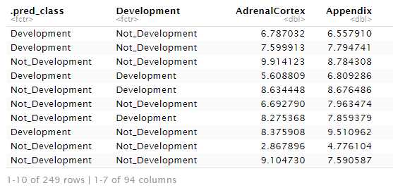
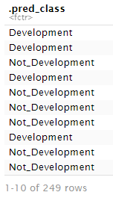
Evaluating / Using the Model
model_fit %>%
predict(new_data=testing(split_data))
%>%
bind_cols(testing(split_data))

Slide 92
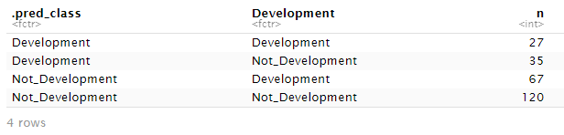
Evaluating / Using the Model
model_fit %>% predict(new_data=testing(split_data)) %>% bind_cols(testing(split_data)) %>% group_by(.pred_class, Development) %>% count()

Slide 93




Evaluating / Using the Model
model_fit %>% predict(new_data=testing(split_data)) %>% bind_cols(testing(split_data)) %>%
sens(Development,.pred_class)
spec(Development,.pred_class)
metrics(Development,.pred_class)

Slide 94
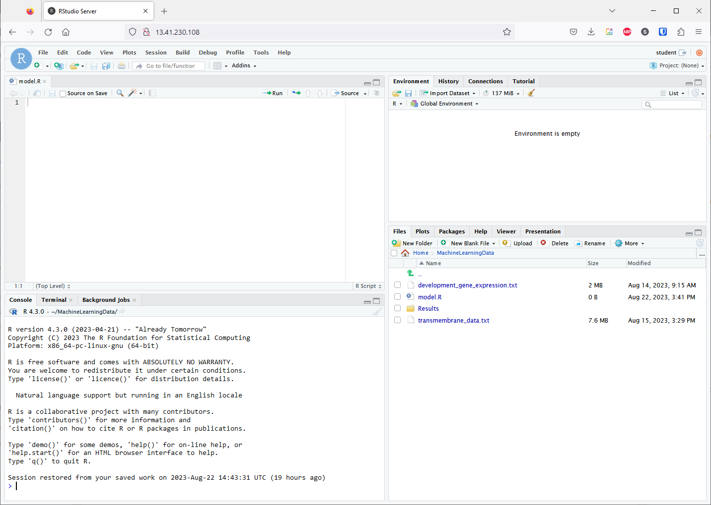
Environment
Data Appears Here
Click name to view it
Script Editor
Code Goes Here
Control + Return to run a line
R Console
Code Runs Here
Output Appears Here

Slide 95
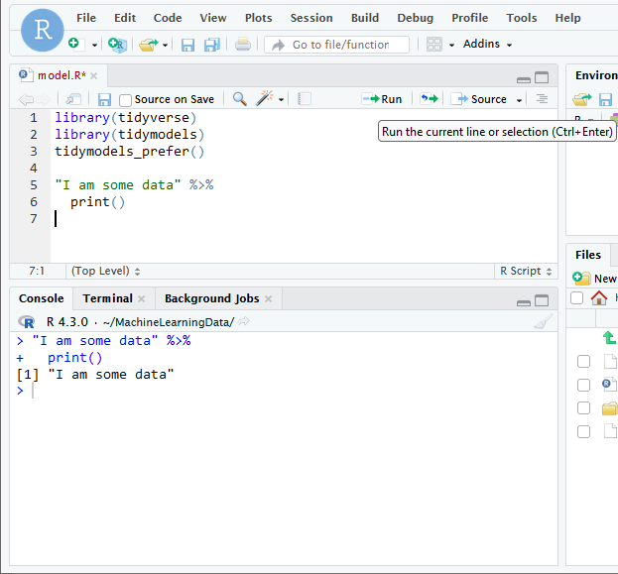
Write Code
Often multi-line statements joined with pipes
Run Code
Cursor on last line
Control + Run or Run button
Examine Output
You should see a copy of the code, along with the output it generated

Slide 96
Exercise: Building a model in tidymodels

Slide 97

Automation with Recipes and Workflows
Preprocessing often has multiple steps
Need to apply these to training, testing and future data
Manually preprocessing is tedious and potentially inconsistent
Recipes let you automate this

Slide 98
Automation with Recipes and Workflows
Create a recipe
Specify formula and optionally data
Add processing steps
Filtering, Transformation etc.
Create a model
Same as we did before
Create a workflow
Combine the recipe and model together

Slide 99
Creating a Recipe
recipe(
var_to_predict ~ .,
data=training(split_data)
) -> my_recipe
You add data here but it's only used to list and type the variables. You still need to provide it when you train or use the model

Slide 100
Recipe Preprocessing Steps
step_rm : Remove one or more variables
step_log: Log transform variables
step_normalize: Convert values to z-scores
step_dummy: Create numerical dummy variables from text
step_other: Combine infrequent categories into an 'other'
step_corr: Remove variables which are highly correlated
step_naomit: Remove rows/columns with missing values
Full list of steps at https://recipes.tidymodels.org/reference/index.html

Slide 101
Applying Steps to Variables
Individually named variables
step_rm(Unsued1, Unused2)
Role selectors
step_normalize(all_numeric_predictors())
step_dummy(all_nominal_predictors())

Slide 102
Adding Preprocessing Steps
my_recipe %>%
step_rm(Unsued1, Unused2) %>%
step_log(expression, gene_length) %>%
step_normalize(all_numeric_predictors()) %>%
step_dummy(all_nominal_predictors()) -> my_recipe

Slide 103

Creating a workflow
Workflows bring together
Recipe (training data, preprocessing, formula)
Model
workflow() %>%
add_recipe(my_recipe) %>%
add_model(my_model) -> my_workflow

Slide 104
Training via a workflow
my_workflow %>%
fit(training(my_data)) -> my_workflow
Fits the model, but also finalises choices in the recipe inside the workflow

Slide 105
Testing via a workflow
my_workflow %>%
predict(new_data=testing(my_data)) %>%
bind_cols(testing(my_data)) %>%
select(.pred_class, var_to_predict)
Predict will automatically pull the trained model out of the workflow and will run the recipe on the new data

Slide 106
Exercise: Automating models with workflows

Slide 107

Optimising Models
We manually selected some parameters for models
Number of hidden nodes / layers (neural net)
Number of random variables to select (random forest)
How do we know we picked the best values?
We perform a search of the parameters.

Slide 108
Adding tuneable parameters
mlp(
epochs = 1000,
hidden_units = 200,
penalty = 0.01,
learn_rate = 0.01
)
mlp(
epochs = 1000,
hidden_units = tune(),
penalty = 0.01,
learn_rate = 0.01
)

Slide 109
Extract tuneable parameters from workflow
workflow %>%
extract_parameter_set_dials()
Collection of 1 parameters for tuning
identifier type object
hidden_units hidden_units nparam[+]
workflow %>%
extract_parameter_set_dials() %>%
extract_parameter_dials("hidden_units")
# Hidden Units (quantitative)
Range: [1, 10]

Slide 110
Customise tuneable parameters
workflow %>%
extract_parameter_set_dials() %>%
update(
hidden_units = hidden_units(c(10,500))
) -> tune_parameters

Slide 111
Grid Search
Generates evenly spaced search parameters over one or more tuneable parameters
grid_regular(tune_parameters, levels=5)
# A tibble: 5 × 1
hidden_units
<int>
1 10
2 132
3 255
4 377
5 500

Slide 112
Running a grid search
Needs data from a cross validation split
workflow %>%
tune_grid(
vdata,
grid = grid_regular(tune_parameters, levels=5),
metrics = metric_set(kap)
) -> tune_results

Slide 113
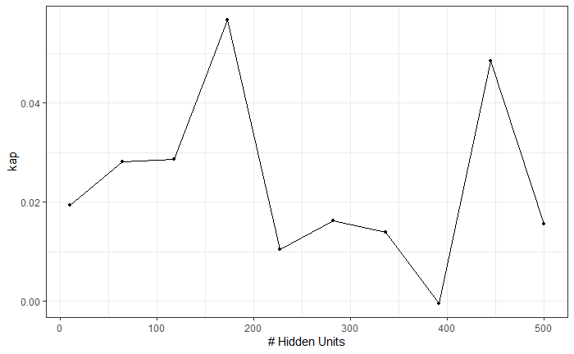
Viewing Search Results
autoplot(tune_results)

